Slide 1
Revelation 17

Slide 2
17 Then one of the seven angels who had the seven bowls came and said to me, “Come, I will show you the judgment of the great prostitute who is seated on many waters, ² with whom the kings of the earth have committed sexual immorality, and with the wine of whose sexual immorality the dwellers on earth have become drunk.” ³ And he carried me away in the Spirit into a wilderness, and I saw a woman sitting on a scarlet beast that was full of blasphemous names, and it had seven heads and ten horns. ⁴ The woman was arrayed in purple and scarlet, and adorned with gold and jewels and pearls, holding in her hand a golden cup full of abominations and the impurities of her sexual immorality.

Slide 3
⁵ And on her forehead was written a name of mystery: “Babylon the great, mother of prostitutes and of earth’s abominations.” ⁶ And I saw the woman, drunk with the blood of the saints, the blood of the martyrs of Jesus.
When I saw her, I marvelled greatly. ⁷ But the angel said to me, “Why do you marvel? I will tell you the mystery of the woman, and of the beast with seven heads and ten horns that carries her. ⁸ The beast that you saw was, and is not, and is about to rise from the bottomless pit and go to destruction. And the dwellers on earth whose names have not been written in the book of life from the foundation of the world will marvel to see the beast, because it was and is not and is to come.

Slide 4
⁹ This calls for a mind with wisdom: the seven heads are seven mountains on which the woman is seated; ¹⁰ they are also seven kings, five of whom have fallen, one is, the other has not yet come, and when he does come he must remain only a little while. ¹¹ As for the beast that was and is not, it is an eighth but it belongs to the seven, and it goes to destruction. ¹² And the ten horns that you saw are ten kings who have not yet received royal power, but they are to receive authority as kings for one hour, together with the beast. ¹³ These are of one mind, and they hand over their power and authority to the beast. ¹⁴ They will make war on the Lamb, and the Lamb will conquer them, for he is Lord of lords and King of kings, and those with him are called and chosen and faithful.”

Slide 5
¹⁵ And the angel said to me, “The waters that you saw, where the prostitute is seated, are peoples and multitudes and nations and languages. ¹⁶ And the ten horns that you saw, they and the beast will hate the prostitute. They will make her desolate and naked, and devour her flesh and burn her up with fire, ¹⁷ for God has put it into their hearts to carry out his purpose by being of one mind and handing over their royal power to the beast, until the words of God are fulfilled. ¹⁸ And the woman that you saw is the great city that has dominion over the kings of the earth.”

Slide 6
Revelation Chapter 17
The enemy of my enemy is not my friend
The Great Prostitute = The Great City “Babylon”

Slide 7
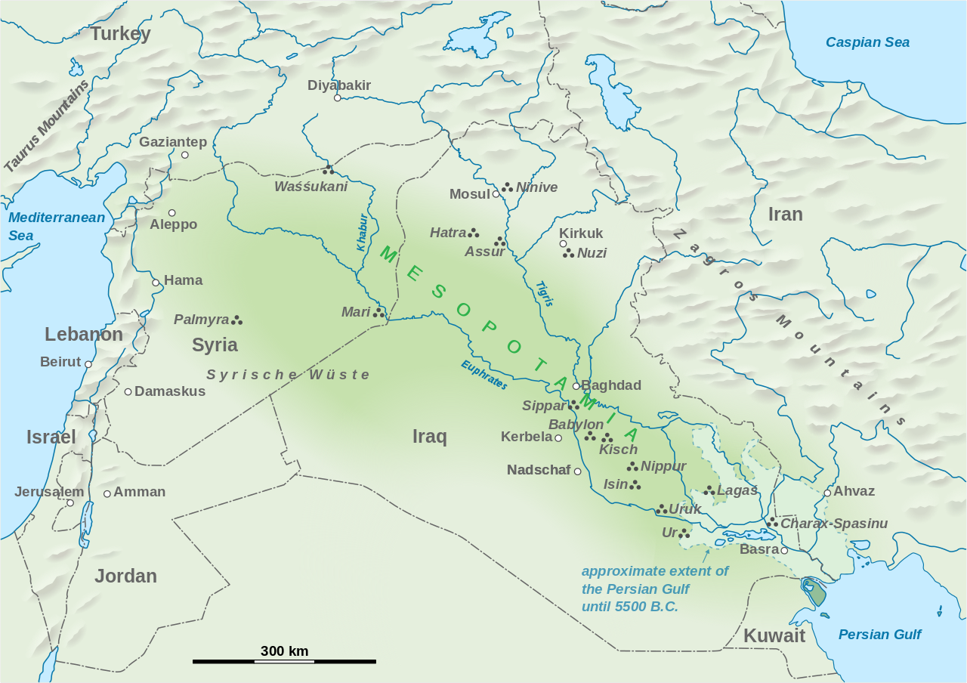
Babylon

Slide 8
Revelation Chapter 17
The enemy of my enemy is not my friend
The Great Prostitute = The Great City “Babylon”
The birth place of civilisation.
The centre of power, influence & affluence
A World Superpower
Biblically, Babylon represents Civilisation against God
Pride
Wealth
Greed
Self-Sufficiency
Immorality
Putting one’s self in the place of God
Narcissism (self-importance; self-entitlement; disregard of others)
Hedonism (self-indulgence in luxuries & pleasures)
Idolatry
Tower of Babel – aimed to make a name for themselves and rise to God’s level
King Nebuchadnezzar – Set himself up as a God to be praised and worshipped

Slide 9
^{Daniel 5:5} Immediately the fingers of a human hand appeared and wrote on the plaster of the wall of the king’s palace, opposite the lampstand. And the king saw the hand as it wrote. ⁶ Then the king’s colour changed, and his thoughts alarmed him; his limbs gave way, and his knees knocked together.

Slide 10
^{Daniel 5:18} O king, the Most High God gave Nebuchadnezzar your father kingship and greatness and glory and majesty. ¹⁹ And because of the greatness that he gave him, all peoples, nations, and languages trembled and feared before him. Whom he would, he killed, and whom he would, he kept alive; whom he would, he raised up, and whom he would, he humbled. ²⁰ But when his heart was lifted up and his spirit was hardened so that he dealt proudly, he was brought down from his kingly throne, and his glory was taken from him. ²¹ He was driven from among the children of mankind, and his mind was made like that of a beast, and his dwelling was with the wild donkeys. He was fed grass like an ox, and his body was wet with the dew of heaven, until he knew that the Most High God rules the kingdom of mankind and sets over it whom he will.

Slide 11
²² And you his son, Belshazzar, have not humbled your heart, though you knew all this, ²³ but you have lifted up yourself against the Lord of heaven. And the vessels of his house have been brought in before you, and you and your lords, your wives, and your concubines have drunk wine from them. And you have praised the gods of silver and gold, of bronze, iron, wood, and stone, which do not see or hear or know, but the God in whose hand is your breath, and whose are all your ways, you have not honoured.

Slide 12
Revelation Chapter 17
The enemy of my enemy is not my friend
The Great Prostitute = The Great City “Babylon”
The birth place of civilisation.
The centre of power, influence & affluence
A World Superpower
Biblically, Babylon represents Civilisation against God
Pride
Wealth
Greed
Self-Sufficiency
Immorality
Putting one’s self in the place of God
Narcissism (self-importance; self-entitlement; disregard of others)
Hedonism (self-indulgence in luxuries & pleasures)
Idolatry
Tower of Babel – aimed to make a name for themselves and rise to God’s level
King Nebuchadnezzar – Set himself up as a God to be praised and worshipped
Belshazzar – Lifted himself against God – (the writing on the wall)

Slide 13
Isaiah 47:
⁸ Now therefore hear this, you lover of pleasures,
who sit securely,
who say in your heart,
“I am, and there is no one besides me;
I shall not sit as a widow
or know the loss of children”:
⁹ These two things shall come to you
in a moment, in one day;
the loss of children and widowhood
shall come upon you in full measure,
in spite of your many sorceries
and the great power of your enchantments.

Slide 14
¹⁰ You felt secure in your wickedness;
you said, “No one sees me”;
your wisdom and your knowledge led you astray,
and you said in your heart,
“I am, and there is no one besides me.”
¹¹ But evil shall come upon you,
which you will not know how to charm away;
disaster shall fall upon you,
for which you will not be able to atone;
and ruin shall come upon you suddenly,
of which you know nothing.

Slide 15
Revelation Chapter 17
The enemy of my enemy is not my friend
The Great Prostitute = The Great City “Babylon”
The birth place of civilisation.
The centre of power, influence & affluence
A World Superpower
Biblically, Babylon represents Civilisation against God
Pride
Wealth
Greed
Self-Sufficiency
Immorality
Putting one’s self in the place of God
Narcissism (self-importance; self-entitlement; disregard of others)
Hedonism (self-indulgence in luxuries & pleasures)
Idolatry
Tower of Babel – aimed to make a name for themselves and rise to God’s level
King Nebuchadnezzar – Set himself up as a God to be praised and worshipped
Belshazzar – Lifted himself against God – (the writing on the wall)
Represents the arrogance of Godless Civilisation

Slide 16
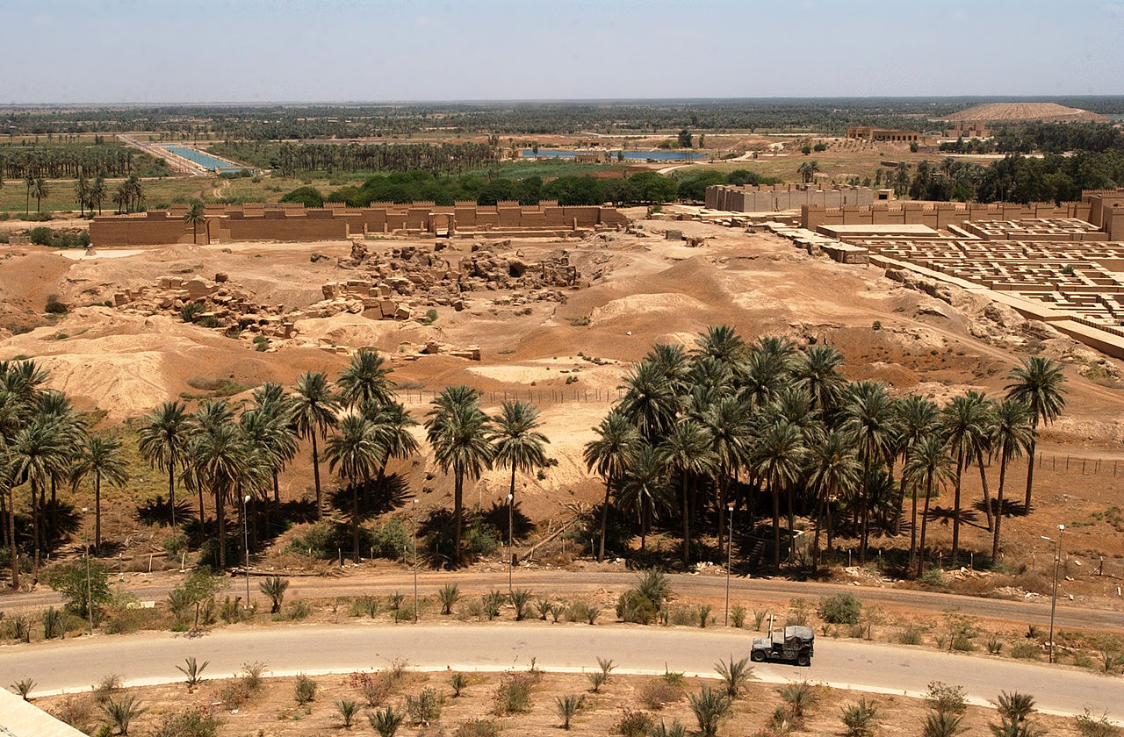

Slide 17
Revelation Chapter 17
The enemy of my enemy is not my friend
The Great Prostitute = The Great City “Babylon”
A World Superpower
Biblically, Babylon represents Civilisation against God
Pride
Wealth
Greed
Self-Sufficiency
Immorality
Putting one’s self in the place of God
Narcissism (self-importance; self-entitlement; disregard of others)
Hedonism (self-indulgence in luxuries & pleasures)
Idolatry
Represents the arrogance of Godless Civilisation & all its worst traits
Babylon is a symbol of anywhere where the greed, luxury and arrogance of world trade is expressed
Living in Babylon:
As a good little Babylonian??? (going along with our godless neighbours); or
As a disciple of Jesus (living counter to our culture)

Slide 18
The Great Prostitute = The Great City “Babylon”
A World Superpower
Biblically, Babylon represents Civilisation against God
Represents the arrogance of Godless Civilisation & all its worst traits
Pride
Wealth
Greed
Self-Sufficiency
Immorality
Putting one’s self in the place of God
Narcissism (self-importance; self-entitlement; disregard of others)
Hedonism (self-indulgence in luxuries & pleasures)
Idolatry
What’s wrong with living as a Babylonian?
Babylon is a society that rejects God
Elevate themselves to the place of God (narcissists, hedonists)
As civilisation rejects God, it rejects His Law
Babylon tramples the world’s poor & takes advantage of the weak

Slide 19
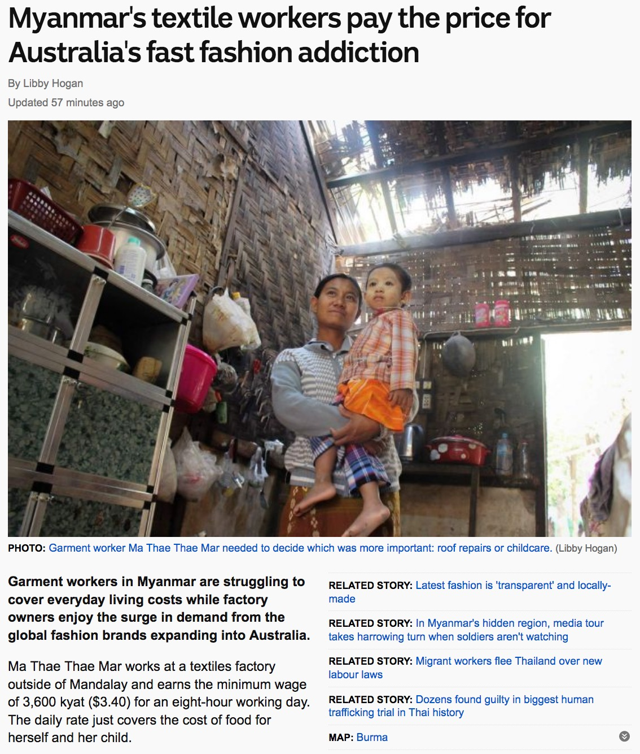

Slide 20
The Great Prostitute = The Great City “Babylon”
A World Superpower
Biblically, Babylon represents Civilisation against God
Represents the arrogance of Godless Civilisation & all its worst traits
Pride
Wealth
Greed
Self-Sufficiency
Immorality
Putting one’s self in the place of God
Narcissism (self-importance; self-entitlement; disregard of others)
Hedonism (self-indulgence in luxuries & pleasures)
Idolatry
What’s wrong with living as a Babylonian?
Babylon is a society that rejects God
Elevate themselves to the place of God (narcissists, hedonists)
As civilisation rejects God, it rejects His Law
Babylon tramples the world’s poor & takes advantage of the weak
Babylon persecutes the disciple of Jesus who live counter to the culture. They preach to the Godless and the arrogant to repent, for there is a God higher than them, to whom they must give an account.

